Slide 1
微處理機系統 &微處理機系統實習

Slide 2
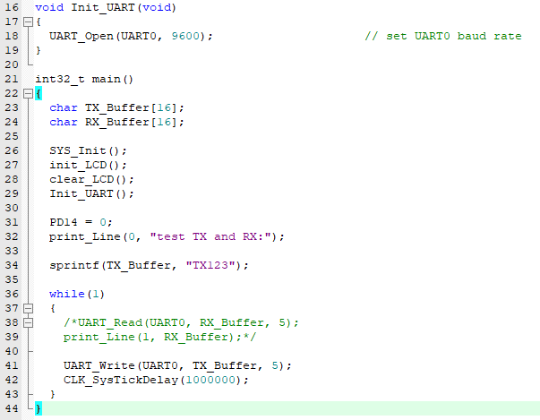
中斷? 輪詢?

Slide 3
t = 0
LED on
t = 1
LED off
t = 2
LED on
t = 3
LED off

Slide 4
t = 0
LED on
CLK_SysTickDelay(10)
LED off
CLK_SysTickDelay(10)
LED on
CLK_SysTickDelay(10)
LED off
CLK_SysTickDelay(10)

Slide 5
t = 0
LED on
CLK_SysTickDelay(1000000)
LED off
CLK_SysTickDelay(1000000)
LED on
CLK_SysTickDelay(1000000)
LED off
CLK_SysTickDelay(1000000)

Slide 7
Learning board
Timer (freq.)
Time’s up
While(1)
{
…….
}

Slide 8
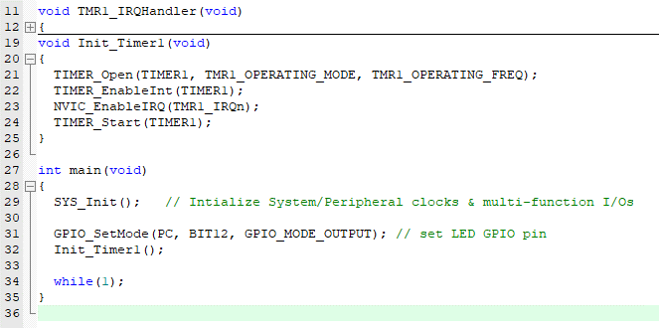

Slide 9
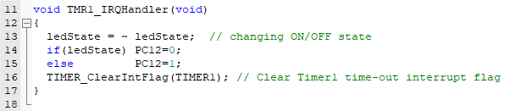

Slide 10
Timer operation modes
One-Shot mode
Periodic mode / Toggle mode
Continuous Counting mode
Interrupt
One shot
0
100
Reset counter
Periodic
0
100
Overflow
Continuous
0
100
101
2²⁴-1

Slide 11
實作
利用timer中斷功能進行實作
key1與key2調整led跑馬燈速度（PC12-PC15）
並使用七段顯示器顯示當前速度值（不限定設計方式）
key3做出一個可以立即反應的功能，例如：LCD背光（PD14）
試試看如果跑馬燈速度變慢的時候，LCD背光的調整會不會變較不即時? 為什麼?

Slide 12


